Slide 1

Linear Programming Simplex Method-Special Cases
School of Data Science and Forecasting
Devi Ahilya Vishwavidyalaya, Indore

Slide 2
Special Cases:
Objective:
To present a theoretical explanation of such situations
To provide a practical interpretation in real-life problems
Special Cases:
Degeneracy
Alternative optima
Unbounded Solutions
Non-existing or Infeasible Solutions

Slide 3
Degeneracy
In the application of the feasibility condition of the simplex method, a tie for the smallest ratio is broken arbitrarily. When a tie happens at least one basic variable will be zero in the next iteration and the new solution is said to be degenerate.
This is in itself not a problem, but making simplex iterations from a degenerate solution may give rise to cycling, meaning that after a certain number of iterations without improvement in objective value the method may turn back to the point where it started.

Slide 4
Degeneracy (Contd.)
Example:
Objective Function:
Maximize Z= 3X₁ + 9X₂
Constraints:
X₁ + 4X₂ ≤ 8
X₁ + 2X₂ ≤ 4
Non-Negativity Conditions:
X_{1,} X₂ ≥ 0

Slide 5
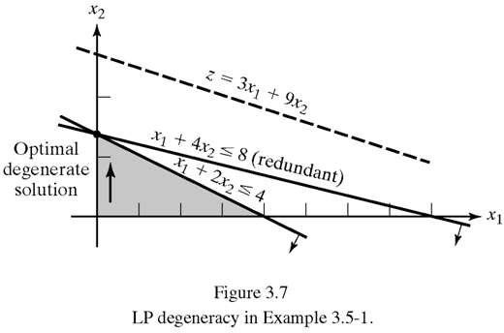
Degeneracy (Contd.)
Graphical Solution:

Slide 6
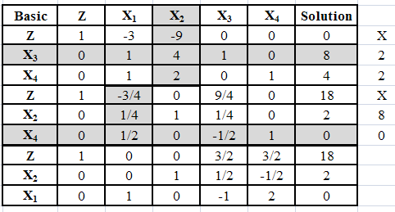
Degeneracy (Contd.)
Simplex Solution:
X1=0, X2 =2, X3 =0, X4=0, Z=18

Slide 7
Implications of Degeneracy:
Practical Implication:
From graph it is clear that optimum point is determined by three lines instead of two. It shows that one of the constraint is redundant.
Some resources are superfluous.
Irregularities in the model construction.
Theoretical Implications:
Phenomenon of cycling.
Set of basic and non-basic variables changes in different iterations but keeping values of all the variables and z same.
Is it possible to stop at the second iteration (when degeneracy appears in first) even though it is not optimum?
The answer is NO, because the solution may be temporarily degenerate.

Slide 8
Alternative Optima:
When the objective function is parallel to a binding constraint (i.e., a constraint that is satisfied as an equation at the optimal solution), the objective function will have the same optimal value, called alternative optima, at more than one solution point.
If the z-row coefficient of one or more non-basic variables is 0 at any iteration, it indicates that the non-basic variable may enter in the basic solution without changing the value of z, but causing a change in the values of the variables. It shows existence of alternate optimal solution.

Slide 9
Alternative Optima (Contd.):
Example:
Objective Function:
Maximize Z= 2X₁ + 4X₂
Constraints:
X₁ + 2X₂ ≤ 5 ………….[1]
X₁ + X₂ ≤ 4 …………[2]
Non-Negativity Conditions:
X_{1,} X₂ ≥ 0

Slide 10
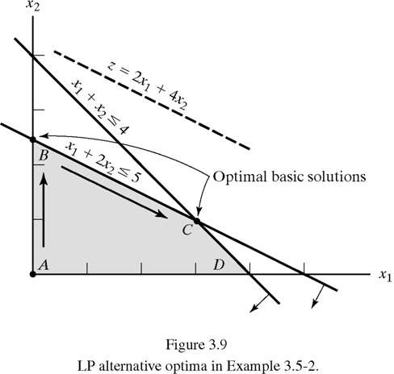
Alternative Optima (Contd.):
Graphical Solution:
Simplex Solution:
The objective function equation is parallel to the binding constraint (1). Therefore, any point on the line segment BC represents an alternative optimum with the same objective value z = 10
Standard Form:
Maximize Z= 2X₁ + 4X₂
Subject to,
X₁ + 2X₂ + X₃ = 5
X₁ + X₂ + X₄ = 4 X_{1,} X_{2 ,} X_{3,} X₄ ≥ 0

Slide 11
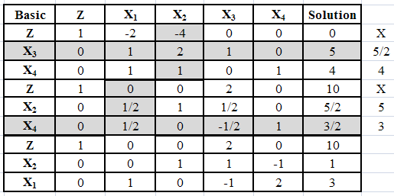
Alternative Optima (Contd.):
Simplex Tableau:
Point B:
X₁ = 0, X₂ = 5/2
Point C:
X₁ = 3, X₂ = 1
All points on the line segment BC
Are given by:
X₁ = α (0) + (1-α) (3) = 3-3α
X₂ = α (5/2) + (1-α) (1) = 1+3/2α
Where α = 0 → 1
Alternative Optima are useful because they allow the management to choose from many solutions without experiencing deterioration in the objective value.

Slide 12
Unbounded Solution:
If the values of the decision variables increase indefinitely without violating any of the constraint, then the solution space is unbounded in at least one direction.
As a result the objective value may increase (maximization case) or decrease (minimization case) indefinitely. If it happens then both the solution space and the optimum objective value are unbounded.
If at any iteration all the constraint coefficients of any non-basic variable are zero or negative, then the solution space is unbounded in that direction. In addition, if the objective coefficient of that variable is negative (maximization case) or positive (minimization case) then the objective function is unbounded as well.
Implication: Unboundedness points to the possibility that the model is poorly constructed. The most likely irregularities in such models are that one or more non-redundant constraints have not been accounted for, and the parameters of some constraints may not have been estimated correctly.

Slide 13
Unbounded Solution (Contd.):
Example:
Objective Function:
Maximize Z= 2X₁ + X₂
Constraints:
X₁ - X₂ ≤ 10 ………….[1]
2X₁ ≤ 40 ……………[2]
Non-Negativity Conditions:
X_{1,} X₂ ≥ 0

Slide 14
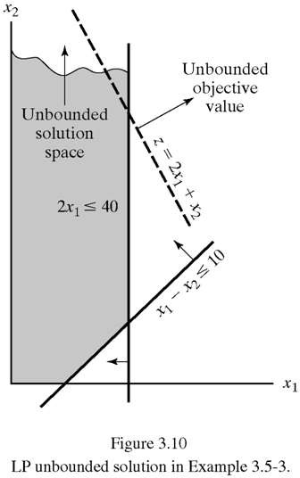
Unbounded Solution (Contd.):
Graphical Solution:
The solution space is unbounded in the direction of X2 and the value of z can be increased indefinitely.
Standard Form:
Maximize Z= 2X₁ + X₂
Subject to,
X₁ - X₂ + X₃ = 10
2X₁ + X₄ = 40 X_{1,} X_{2 ,} X_{3,} X₄ ≥ 0

Slide 15
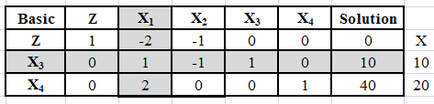
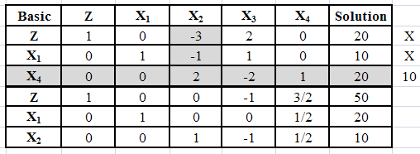
Unbounded Solution (Contd.):
Simplex Solution:
Starting Feasible Solution:
Both X₁, X₂ are candidates for entering the solution. But all the constraint coefficient under X₂ are negative or zero, meaning that X₂ can be increased indefinitely without violating any of the constraints. Any increase in X₂ will increase Z also so it can be increased to ∞ as X₂ → ∞. Thus the problem is unbounded in the direction of X₂.

Slide 16
Infeasible Solution:
LP models with inconsistent constraints have no feasible solution.
If all the constraints are not satisfied simultaneously, the model has no feasible solution space.
This situation can never occur if all the constraints are of the type ≤ with non-negative RHS. Here we use slack variables and get a feasible solution.
For other type of constraints artificial variables are used and penalized in the objective function to force them to zero at the optimum, this can occur only if the model has feasible space. Otherwise at least one artificial variable will be positive in the optimum solution.

Slide 17
Infeasible Solution (Contd.):
Example:
Objective Function:
Maximize Z= 3X₁ + 2X₂
Constraints:
2X₁ + X₂ ≤ 2 ………….[1]
3X₁ + 4X₂ ≥ 12 …………[2]
Non-Negativity Conditions:
X_{1,} X₂ ≥ 0

Slide 18
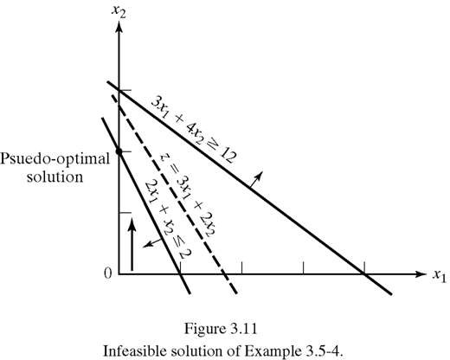
Infeasible Solution (Contd.):
Graphical Solution:
No Feasible Solution Space
Standard Form:
Maximize Z= 3X₁ + 2X₂
Subject to,
2X₁+X₂+X₃ = 2
3X₁+4X₂-X₄+R = 12
X_{1,} X_{2 ,} X_{3,} X_{4,} R ≥ 0

Slide 19
Infeasible Solution (Contd.):
Solution (Big-M Method):
Iteration | Basic | X₁ | X₂ | X₄ | X₃ | R | Solution
0 X₂ enters X₃ leaves | Z | -3-3M | -2-4M | M | 0 | 0 | -12M
 | X₃ | 2 | 1 | 0 | 1 | 0 | 2
 | _{R} | 3 | 4 | -1 | 0 | 1 | 12
1 Pseudo optimum | _{Z} | 1+5M | 0 | M | 2+4M | 0 | 4-4M
 | X₂ | 2 | 1 | 0 | 1 | 0 | 2
 | _{R} | -5 | 0 | -1 | -4 | 1 | 4
In optimum solution R is positive (=4). It indicates that the solution is infeasible.

Slide 20
Infeasible Solution (Contd.):
Solution (Two Phase Method):
Phase-I: Min. W = R
Subject to,
2X₁+X₂+X₃ = 2
3X₁+4X₂-X₄+R = 12
X_{1,} X_{2 ,} X_{3,} X_{4,} R ≥ 0
Iteration | Basic | X₁ | X₂ | X₄ | X₃ | R | Solution
0 X₂ enters X₃ leaves | W | 3 | 4 | -1 | 0 | 0 | 12
 | X₃ | 2 | 1 | 0 | 1 | 0 | 2
 | _{R} | 3 | 4 | -1 | 0 | 1 | 12
1 optimum | _{W} | -5 | 0 | -1 | -4 | 0 | 4
 | X₂ | 2 | 1 | 0 | 1 | 0 | 2
 | _{R} | -5 | 0 | -1 | -4 | 1 | 4
In optimum solution W ≠ 0. Therefore, cannot proceed to Phase-II and the solution is infeasible.

Slide 21
Thank You!
Dr. V.B.Gupta
+ 91 99933 50547
vbgupta.davv@gmail.com

